Slide 1
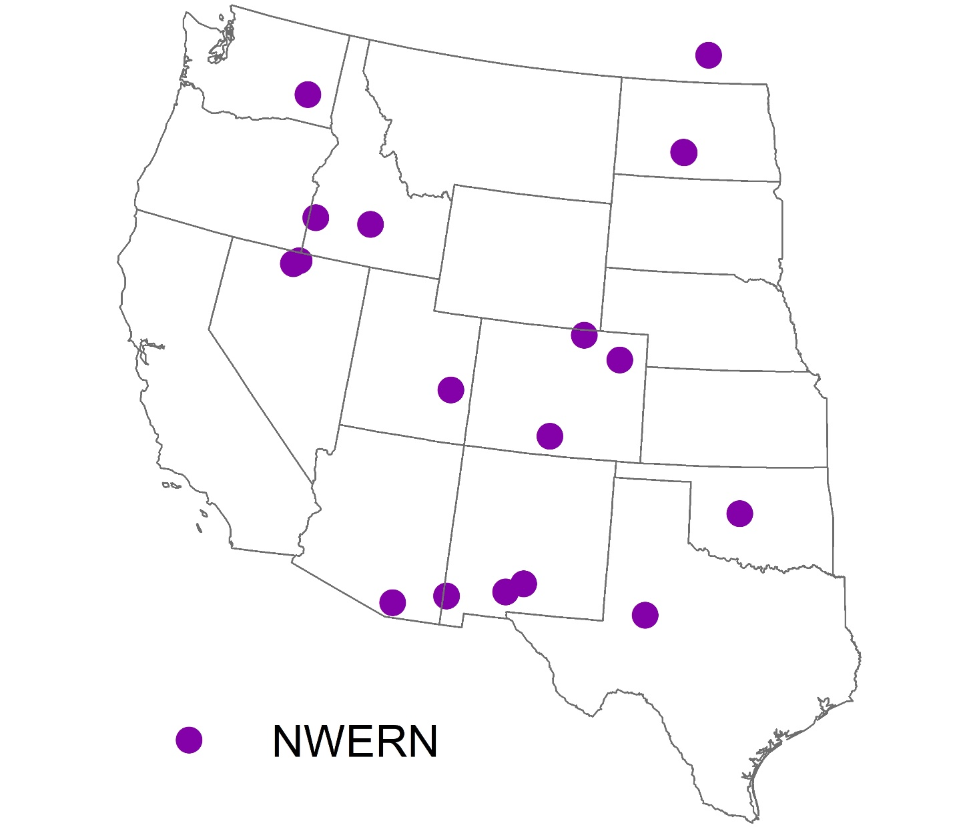
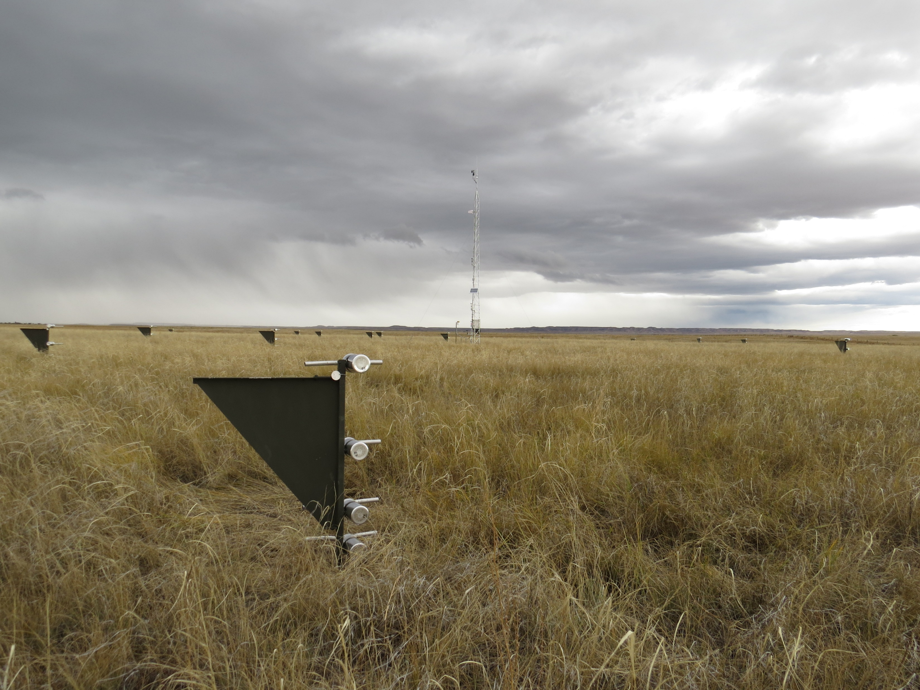

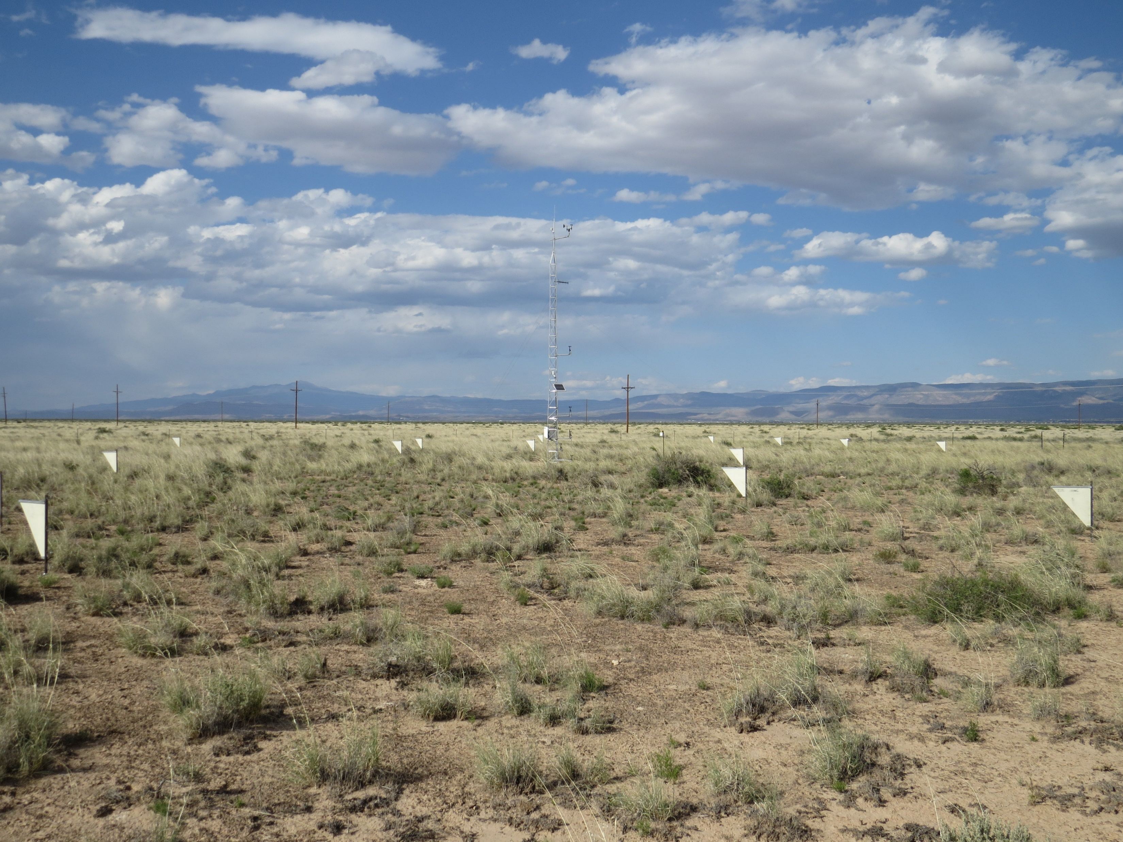
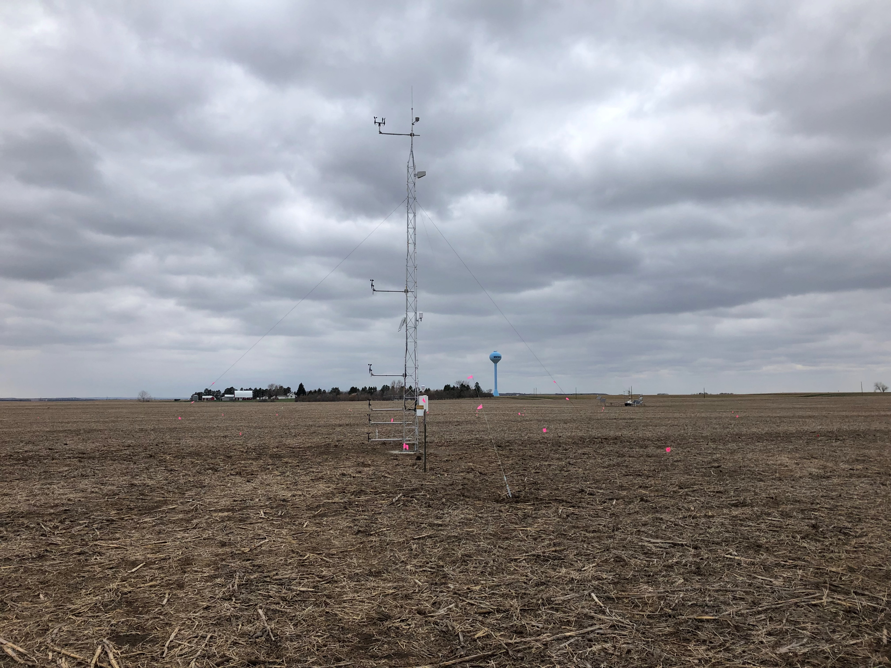
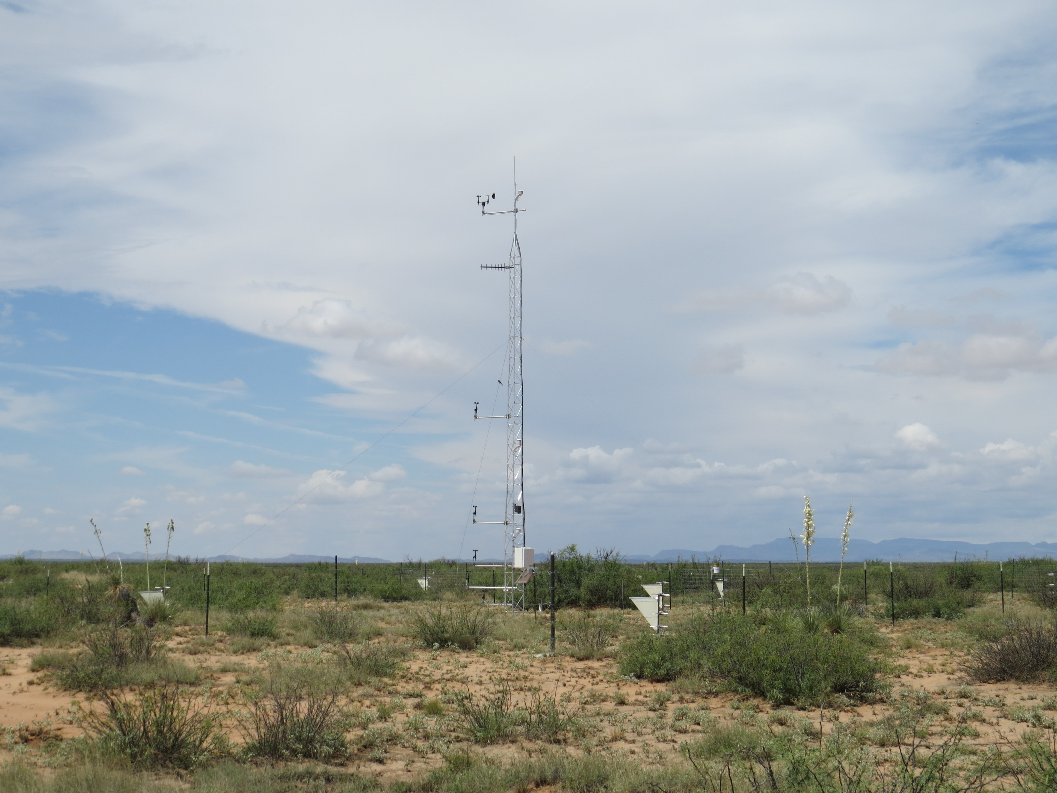
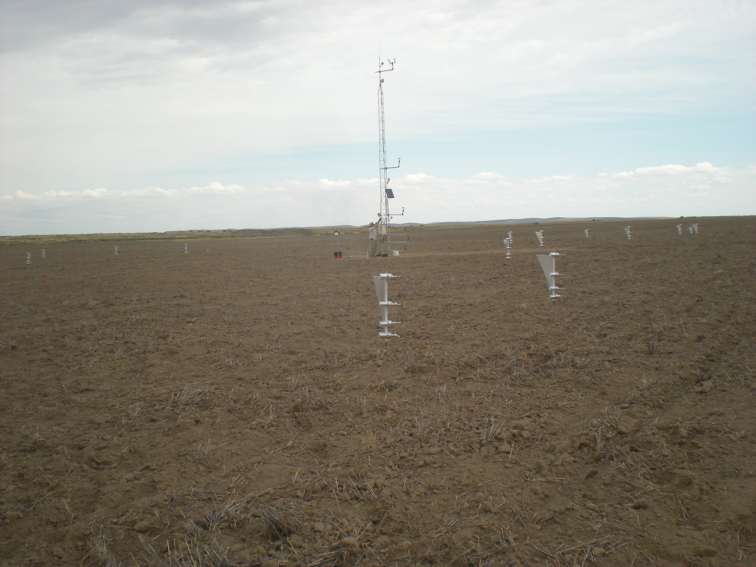
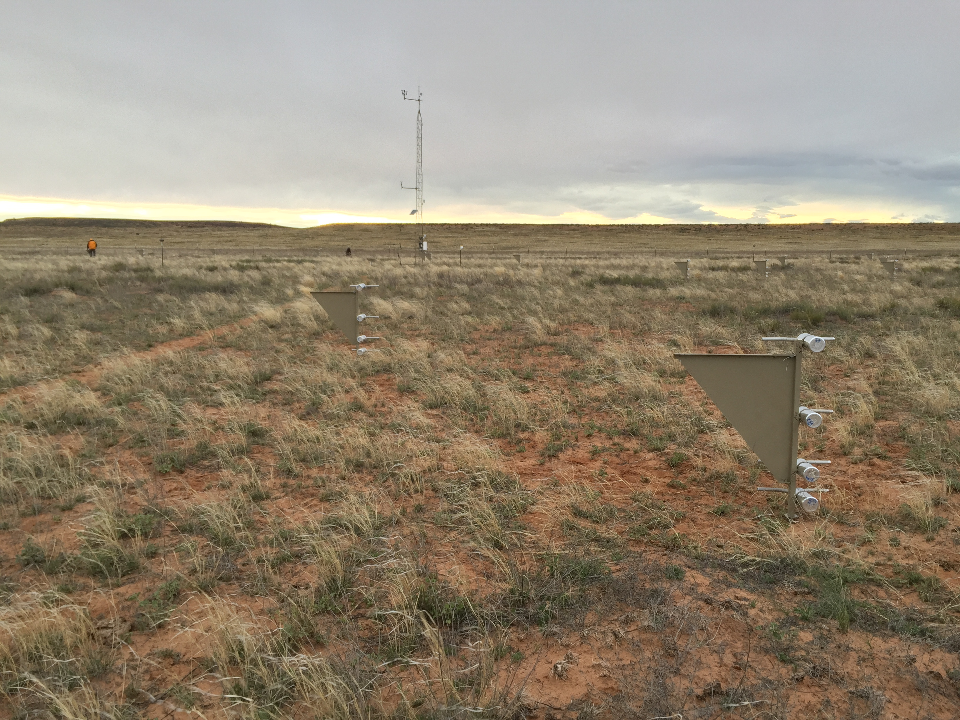
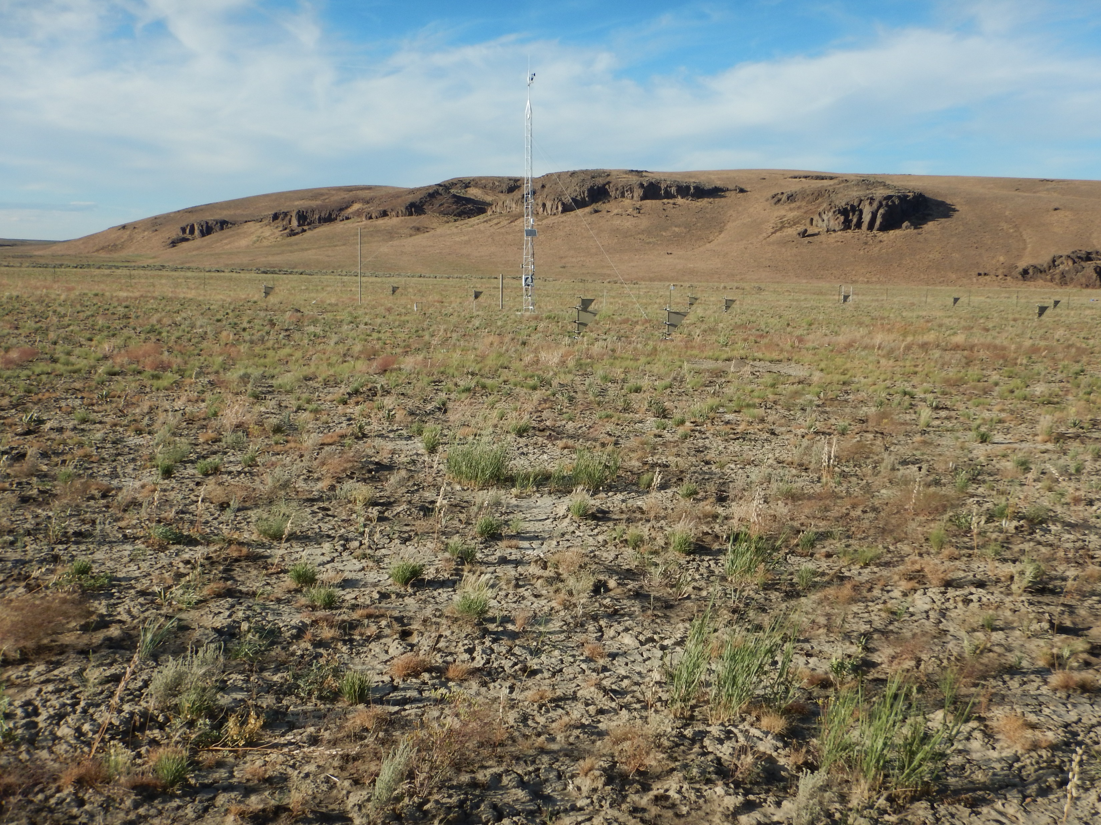
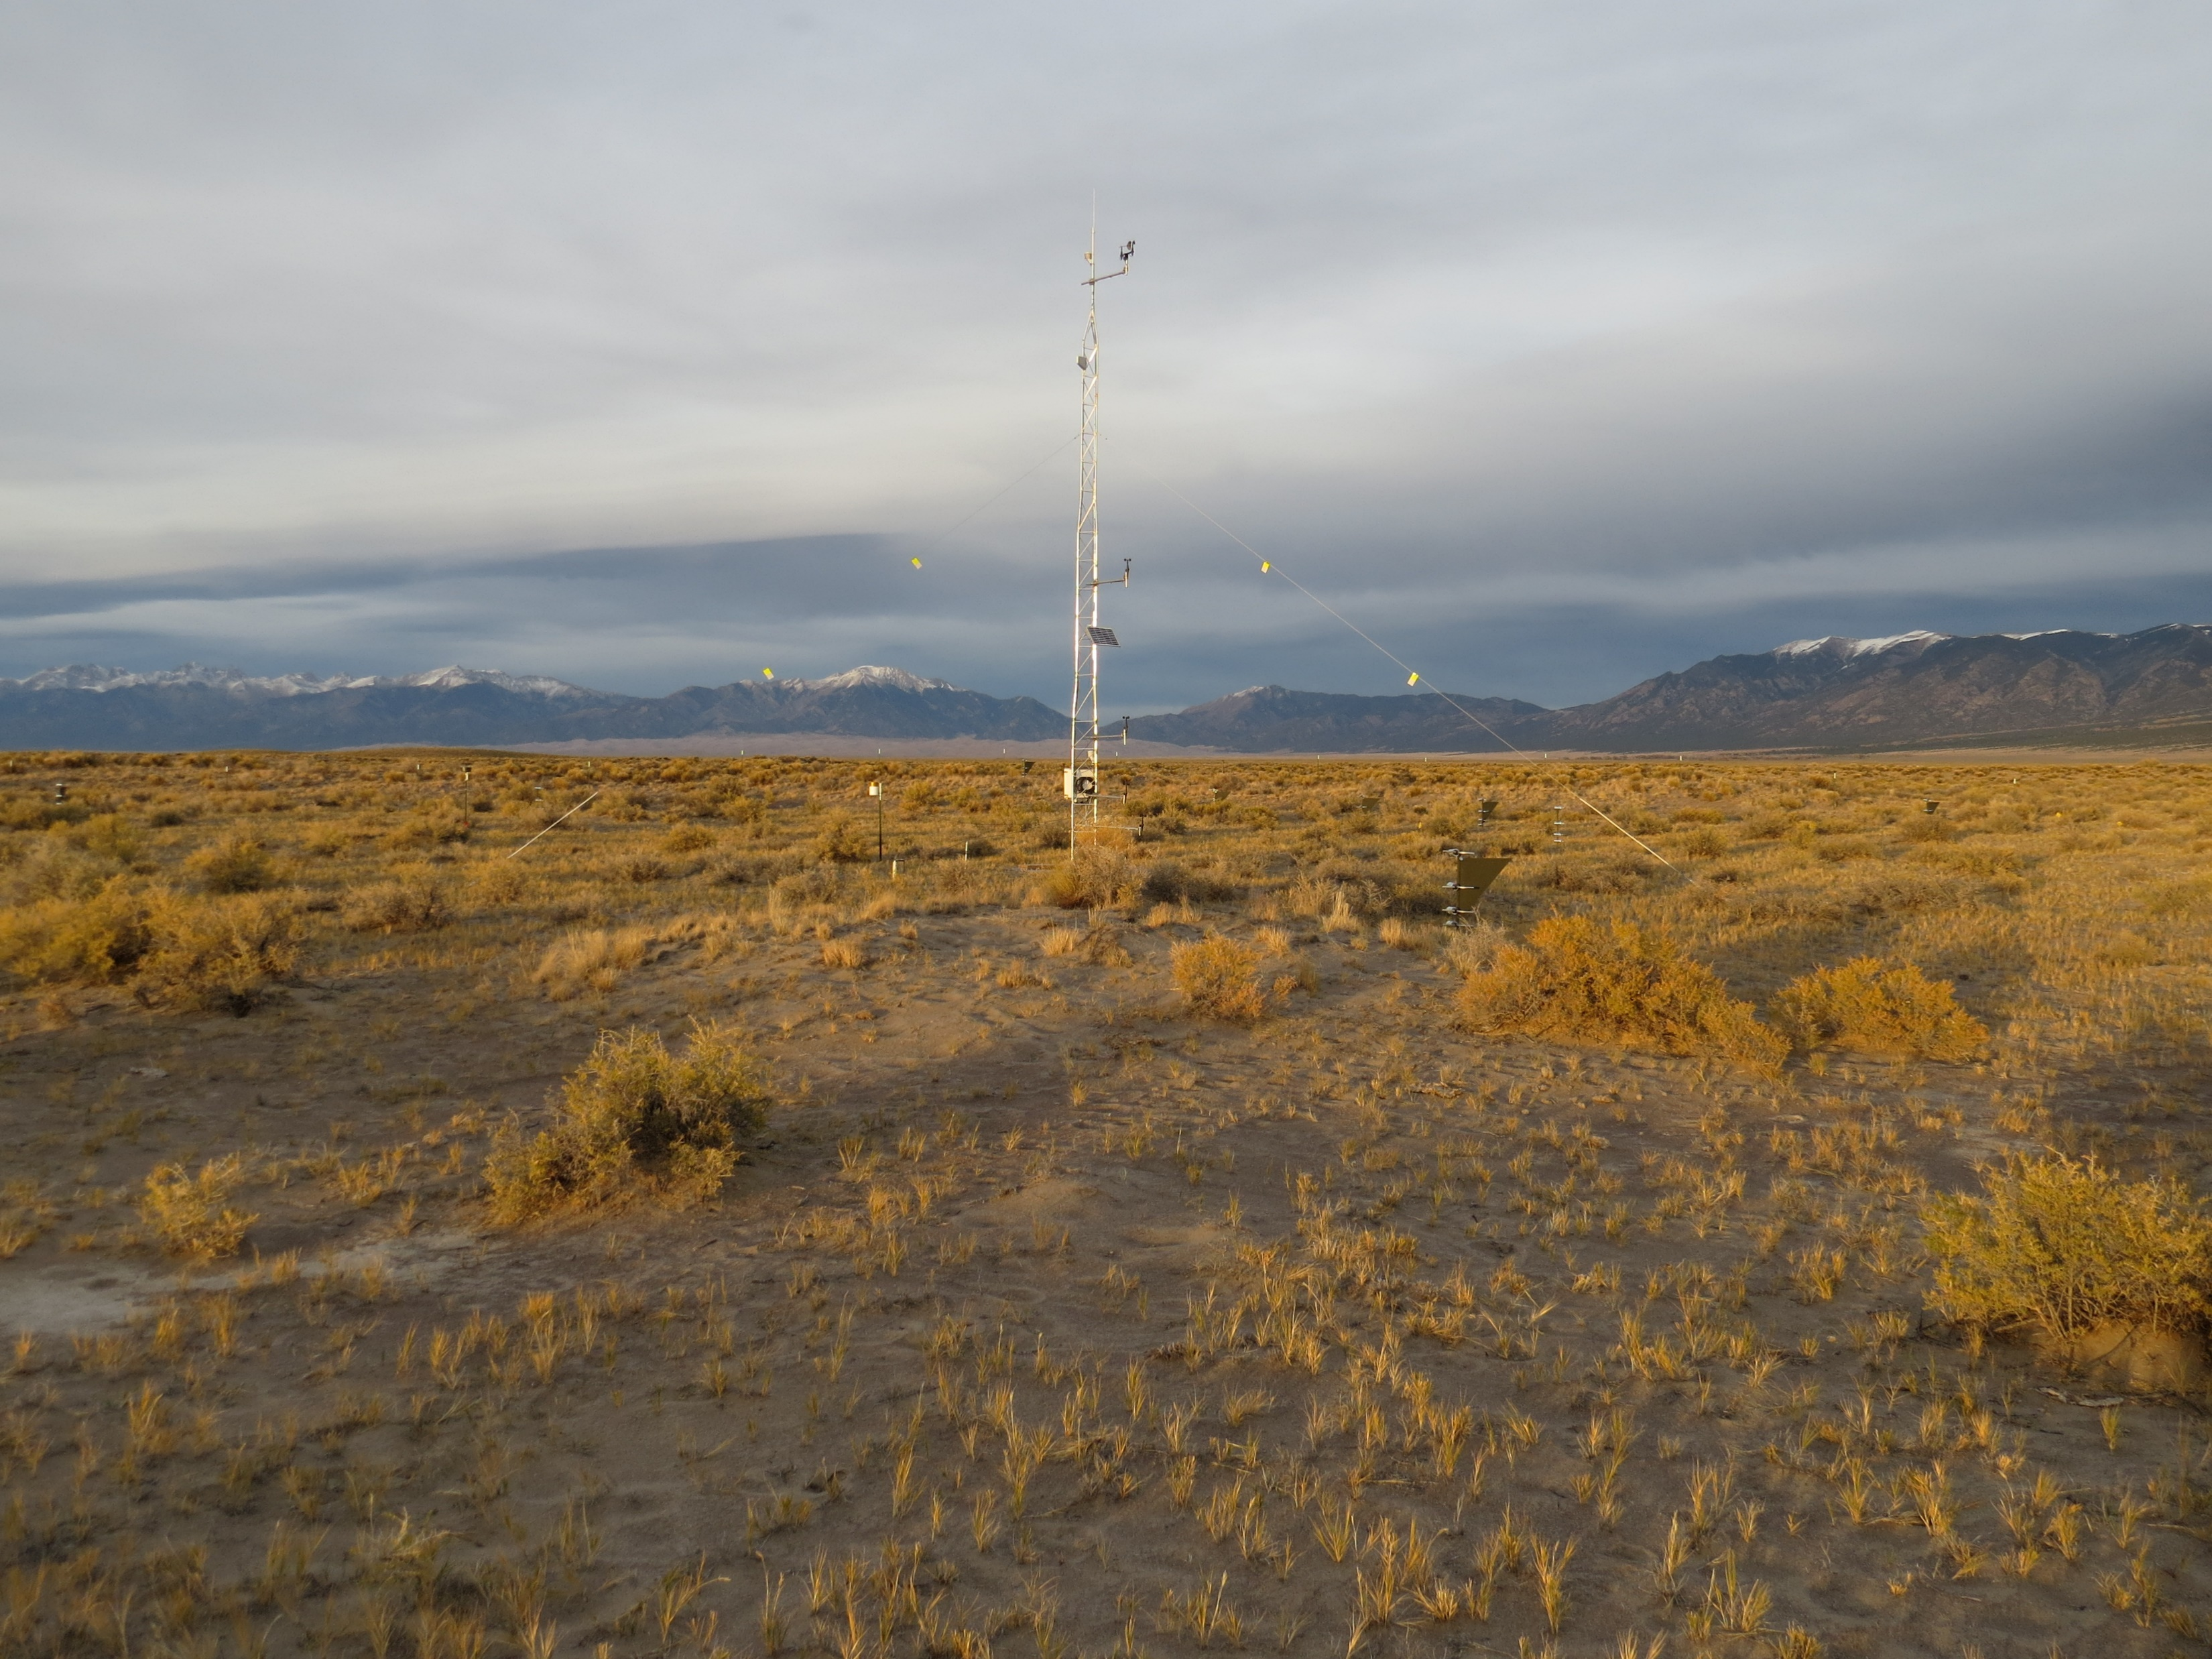
CPER
Lordsburg
Holloman
Morton
Jornada
Pullman
100 m
Moab
Red Hills
San Luis Valley

Slide 2
LPI

Slide 3
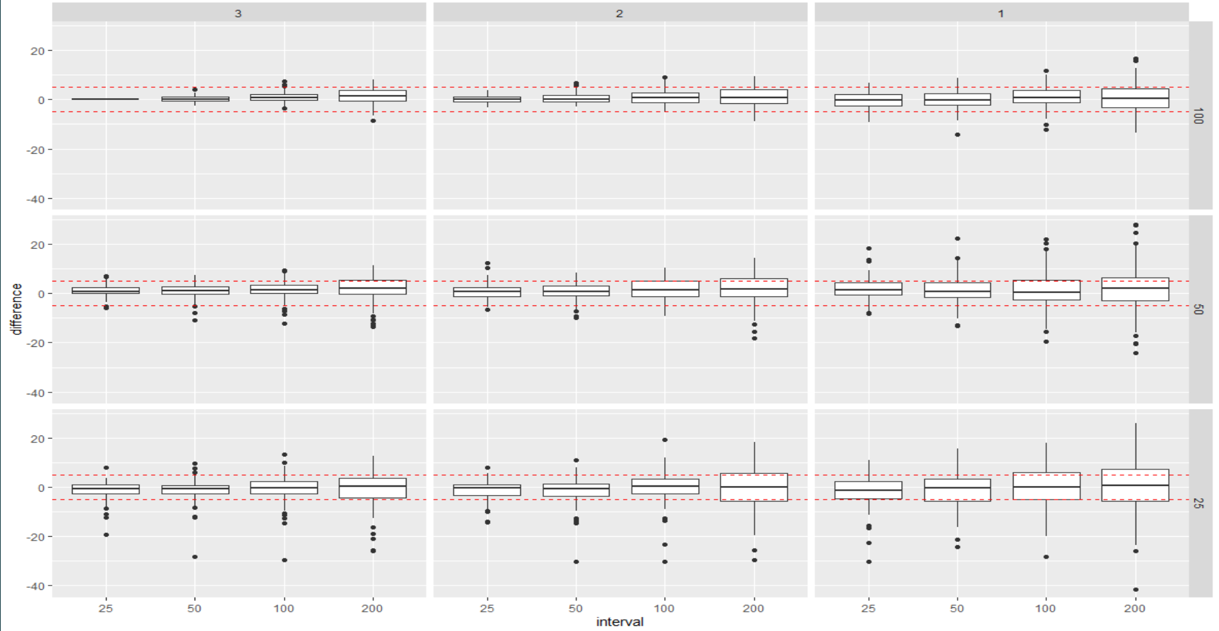
Difference from NWERN base

Slide 4
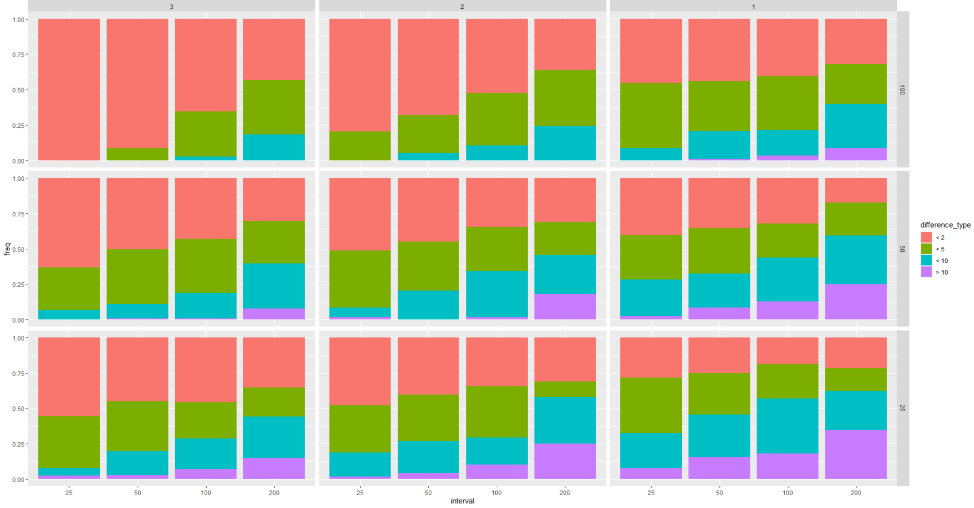
Proportion of difference from NWERN Base

Slide 5
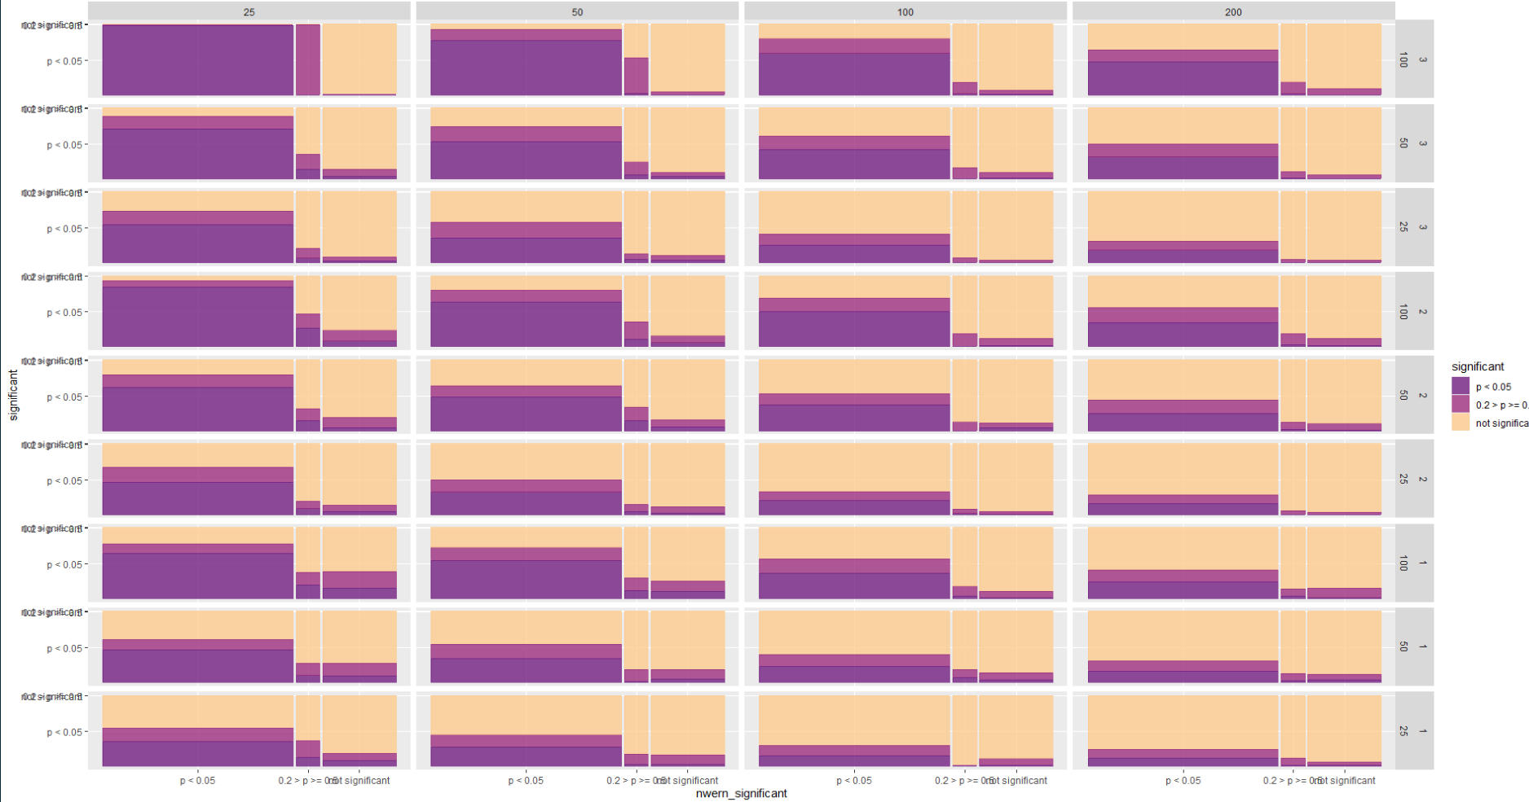
Plot visit significant differences –both p < 0.05 and p < 0.2

Slide 6
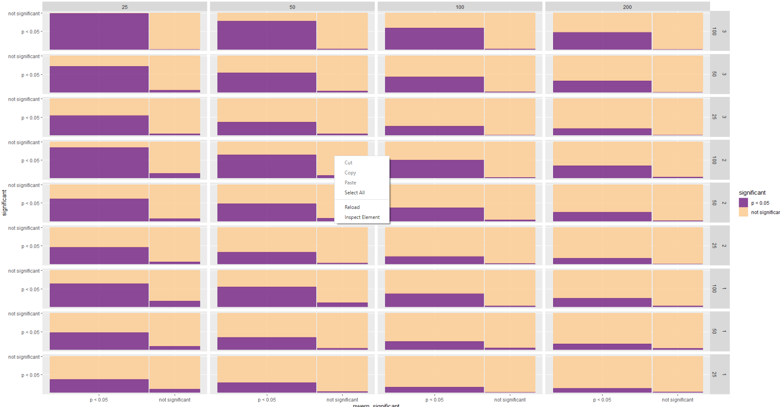
Plot visit significant differences p < 0.05

Slide 7
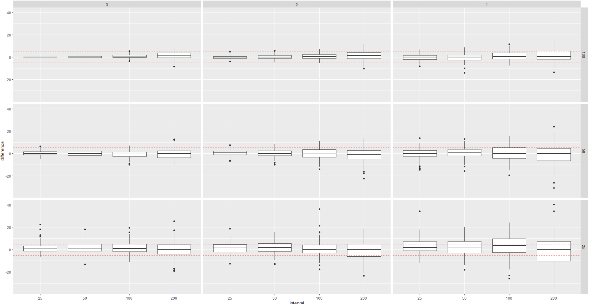
Difference from NWERN base

Slide 8
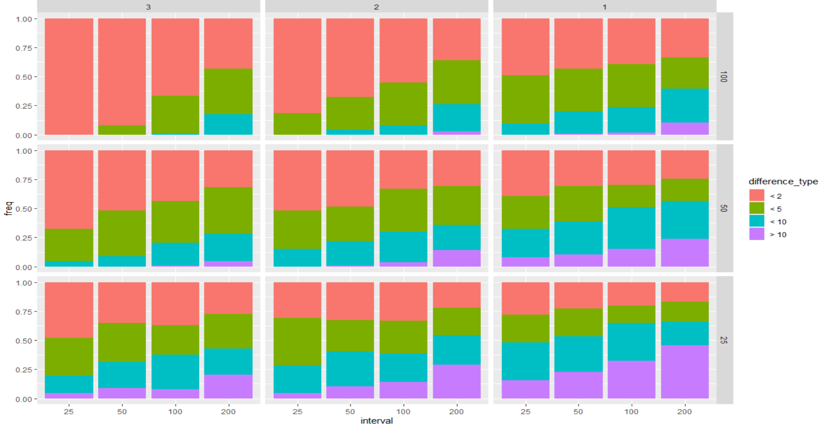
Proportion of difference from NWERN Base

Slide 9
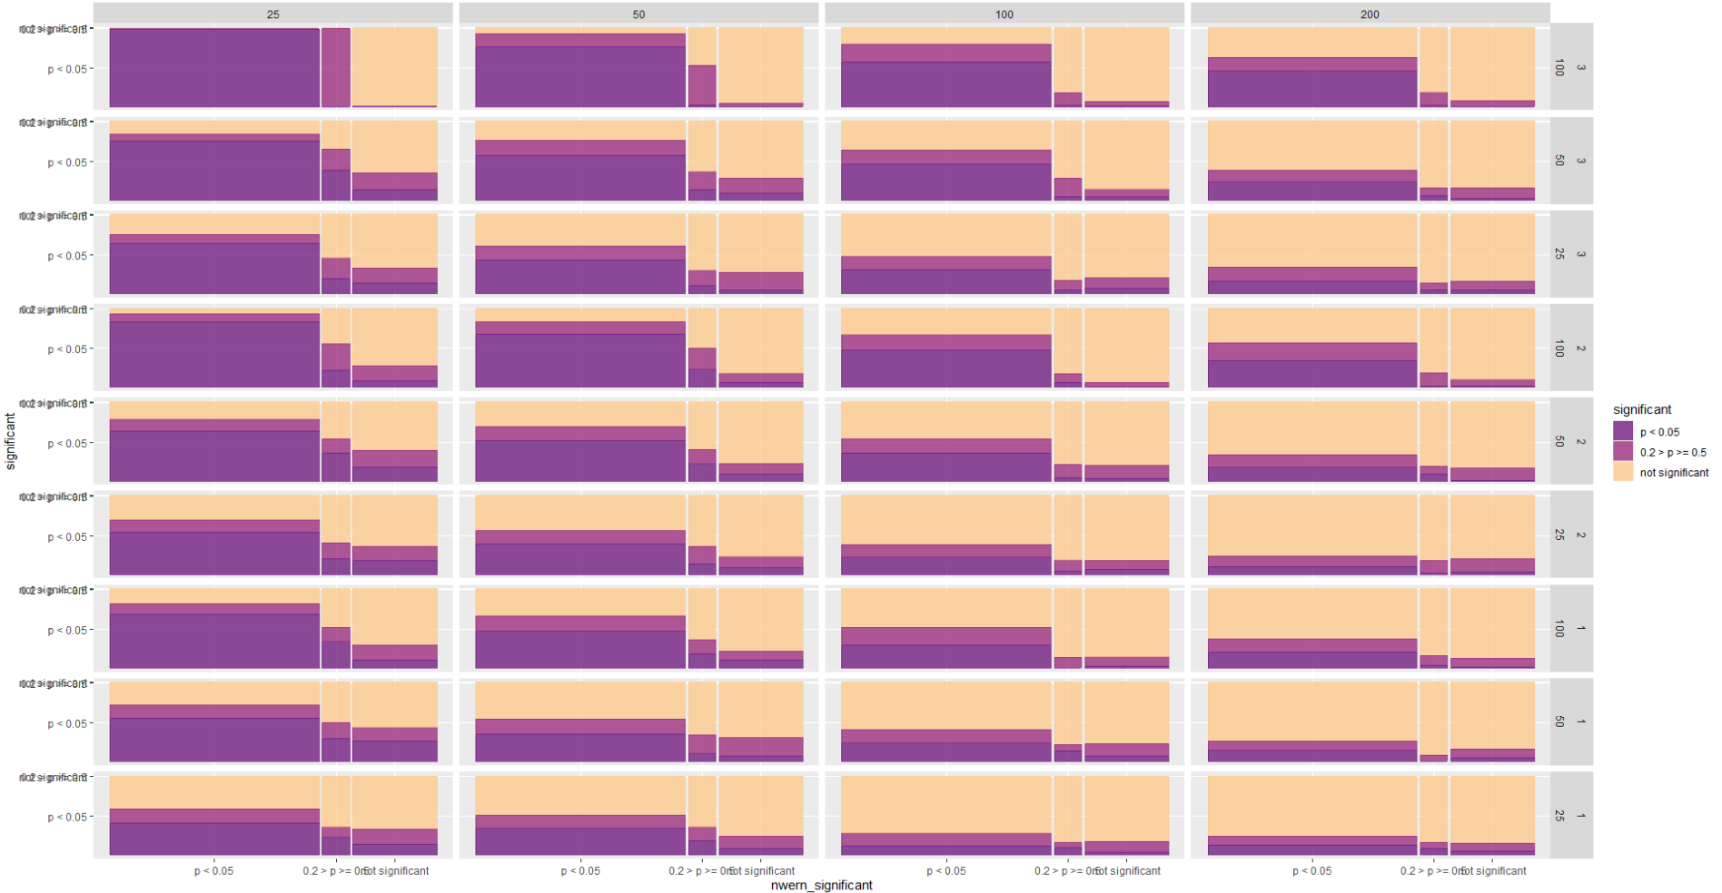
Plot visit significant differences –both p < 0.05 and p < 0.2

Slide 10
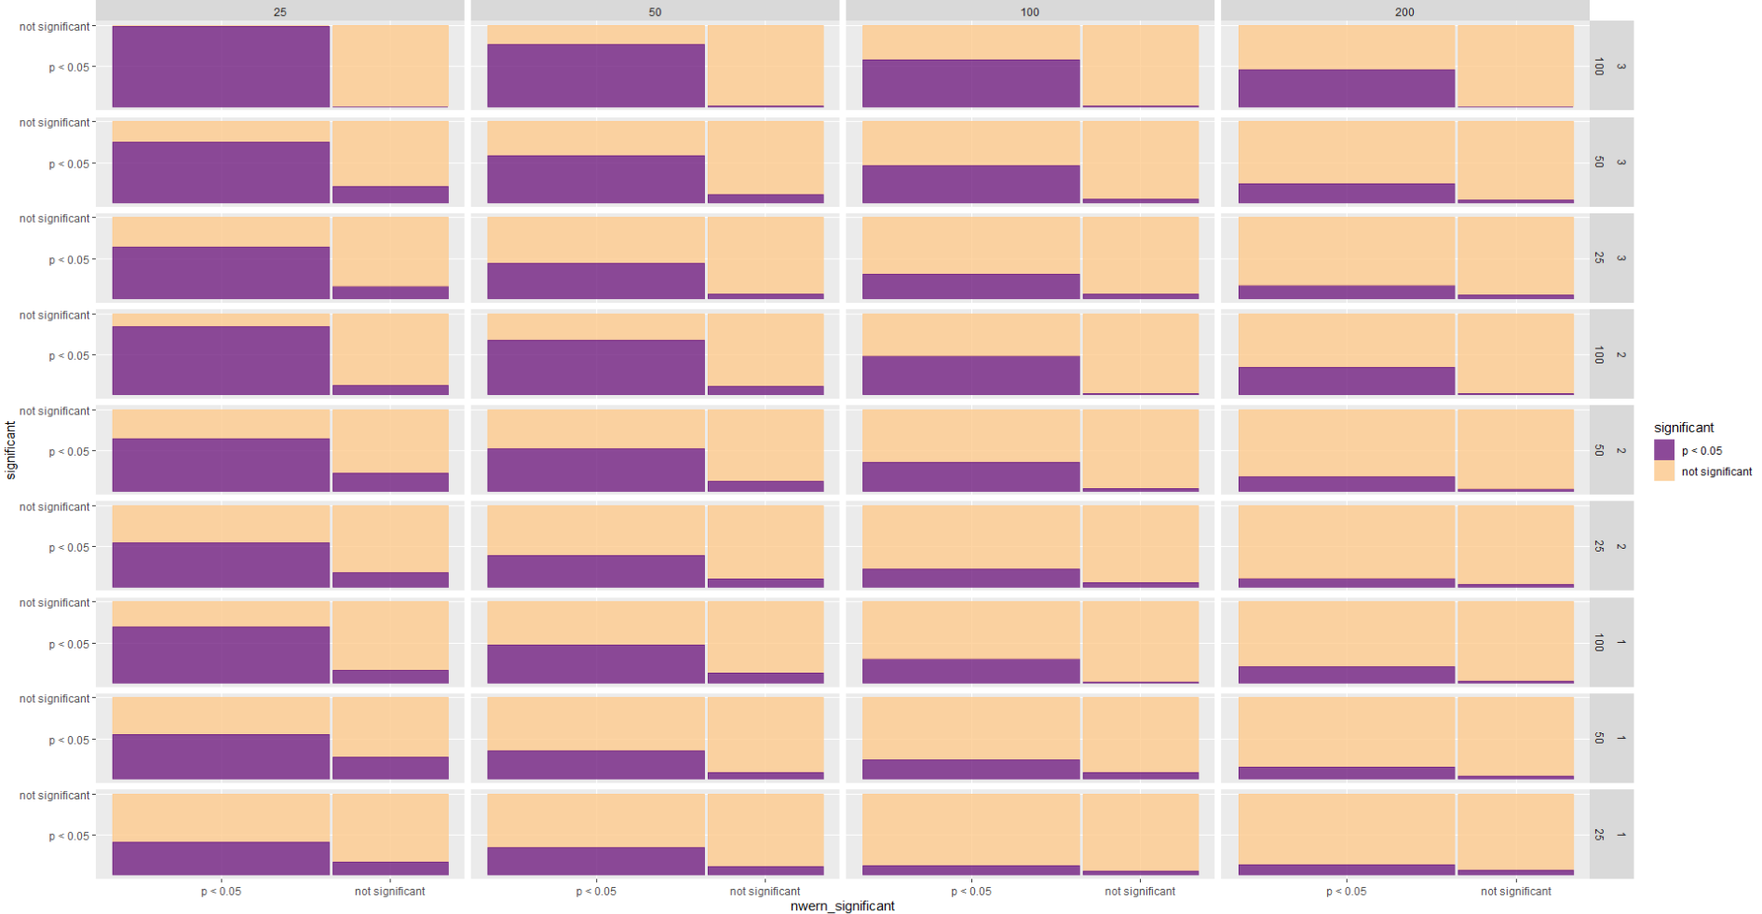
Plot visit significant differences p < 0.05

Slide 11
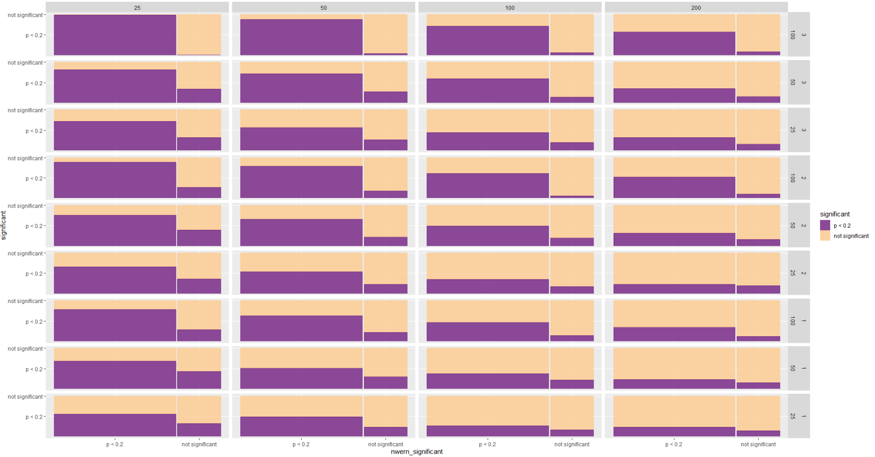
Plot visit significant differences p < 0.2

Slide 12
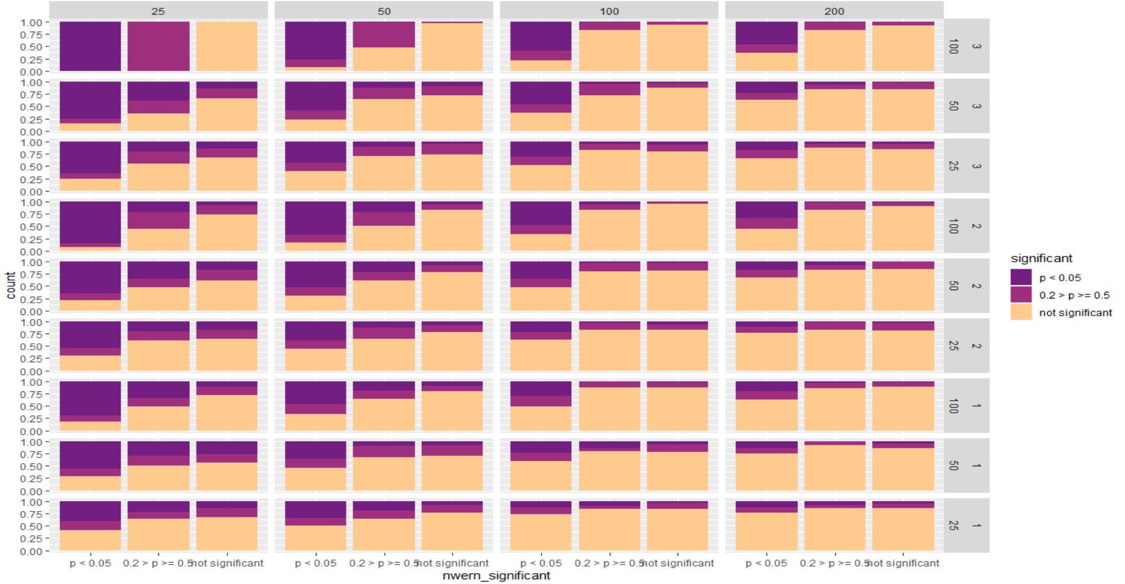
Proportion - Plot visit significant differences –both p < 0.05 and p < 0.2

Slide 13
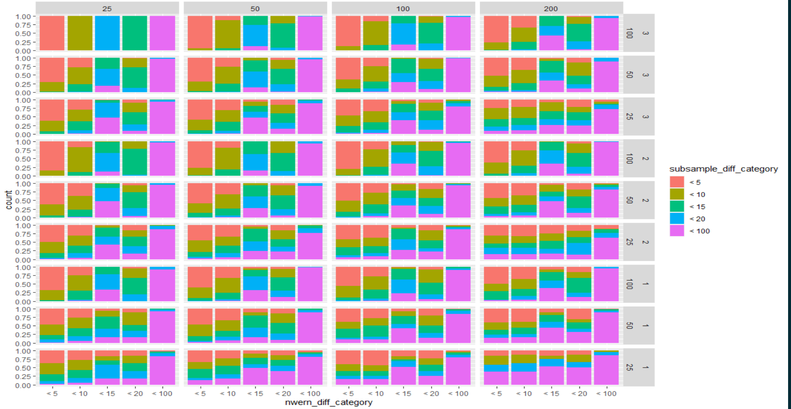
Plot visit absolute differences

Slide 14
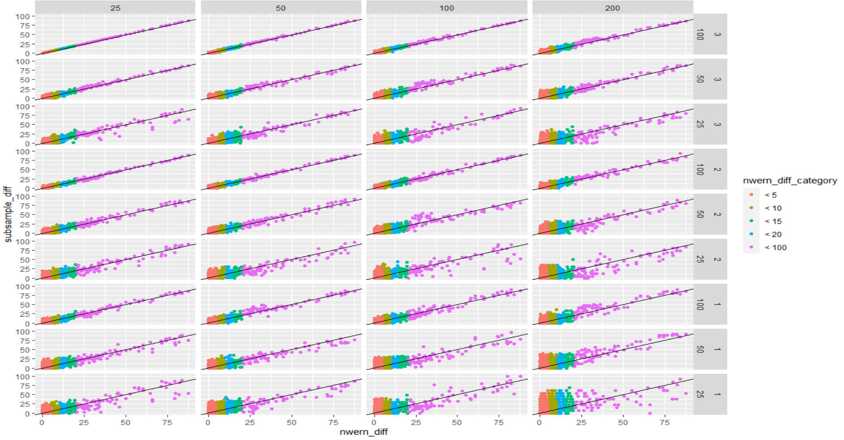
Plot visit absolute differences

Slide 15
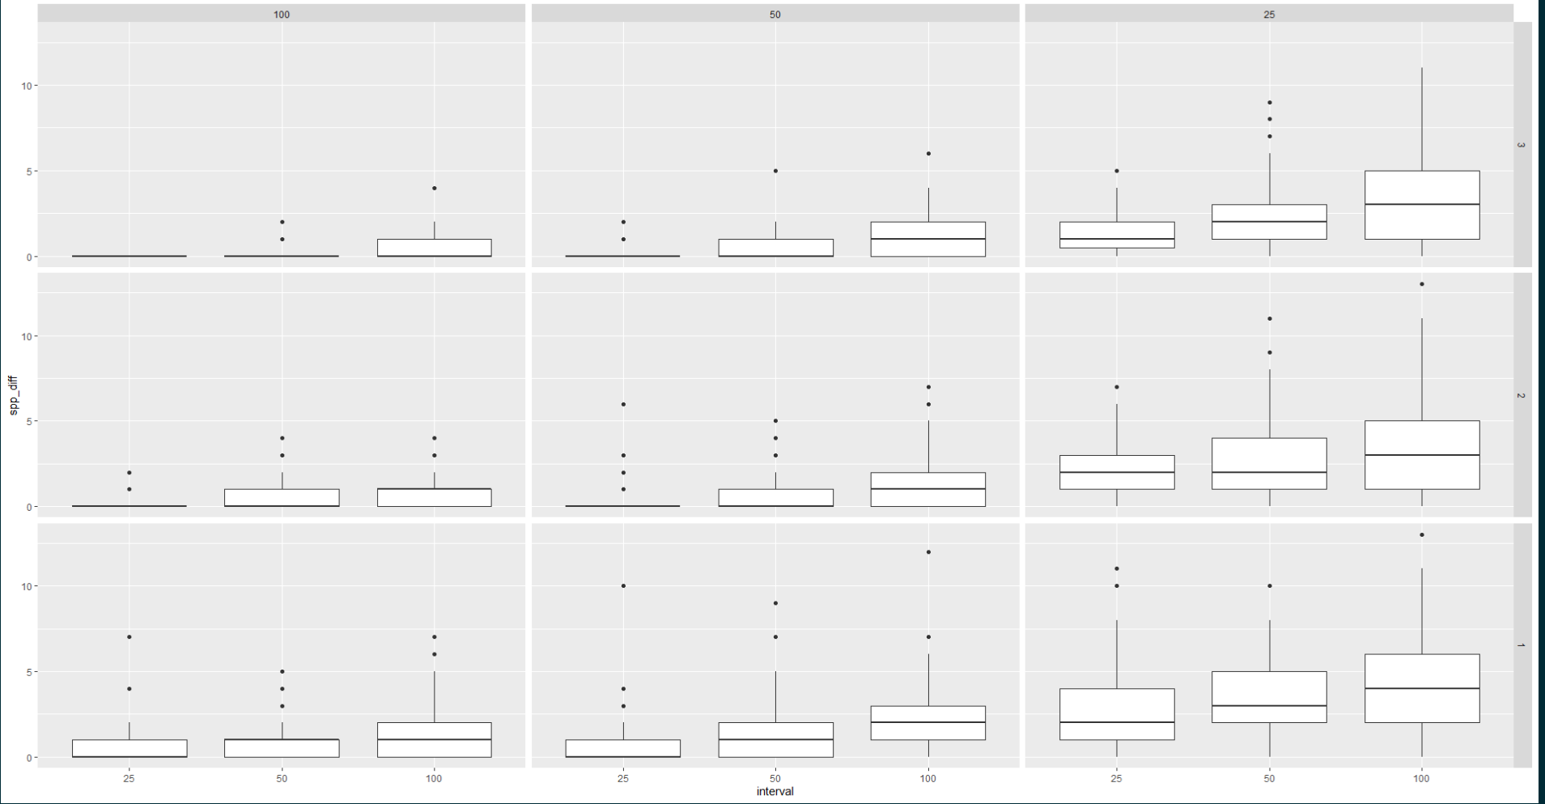
Species detection – difference in number

Slide 16
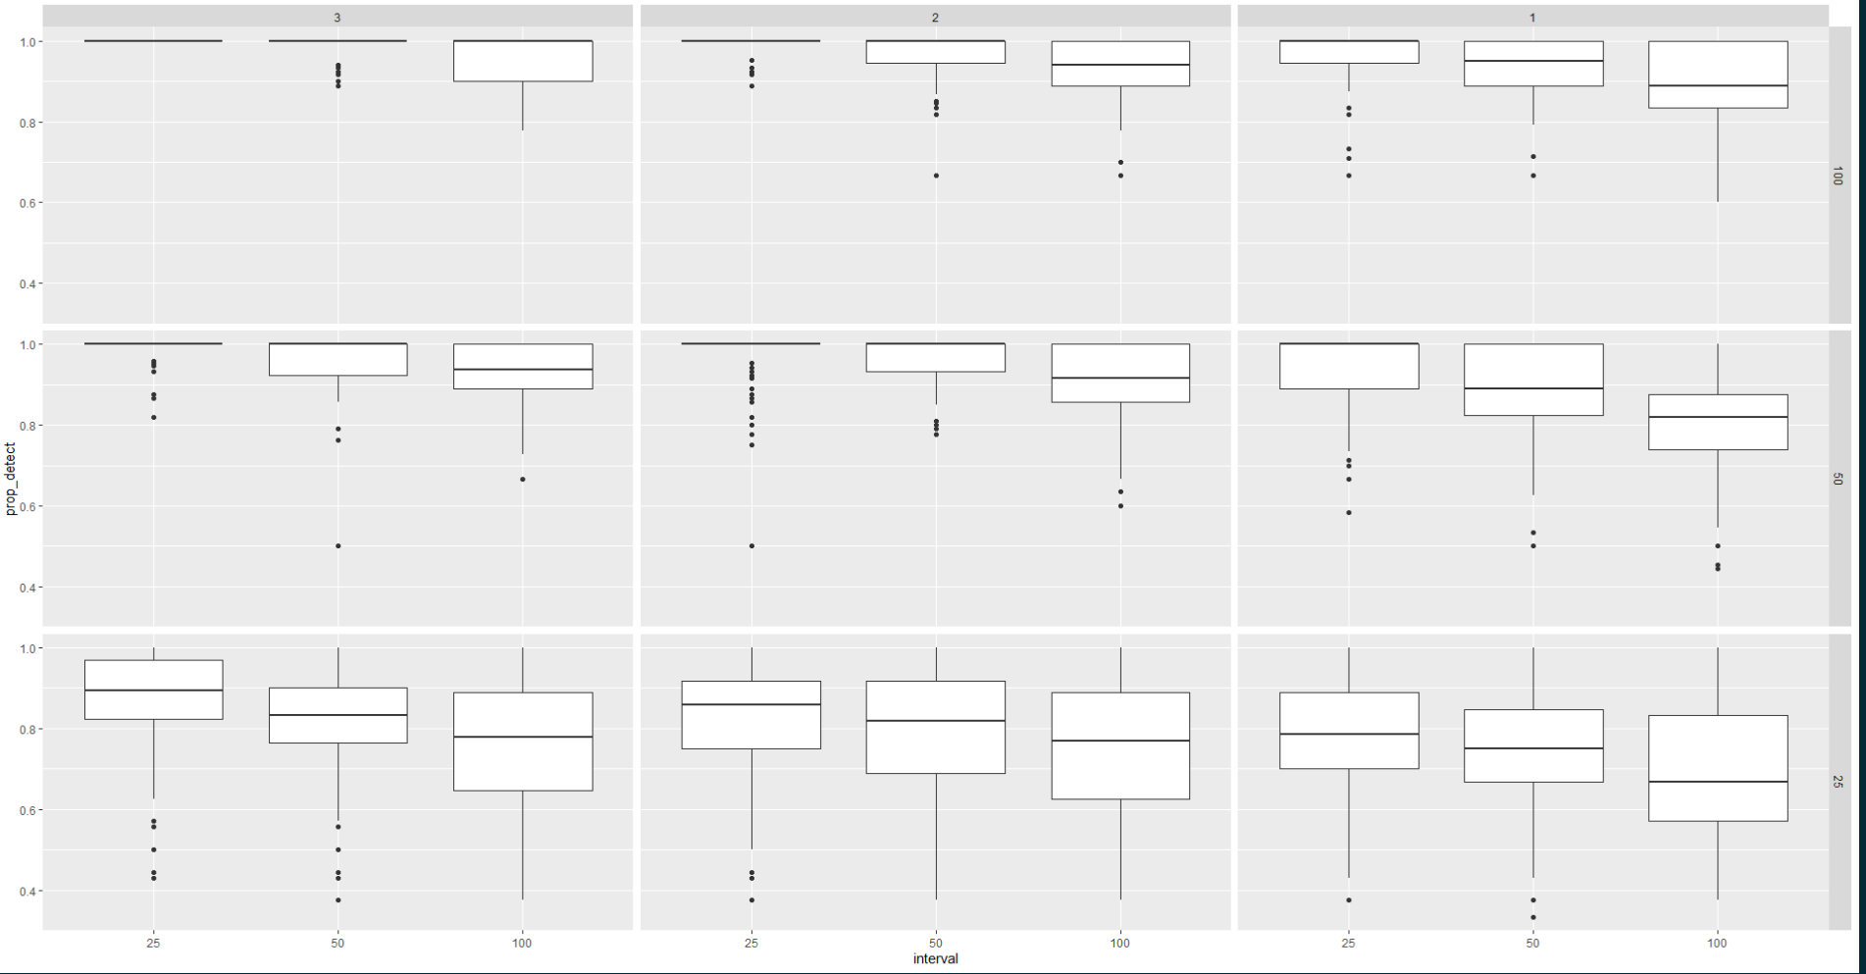
Species detection – proportion detected

Slide 17
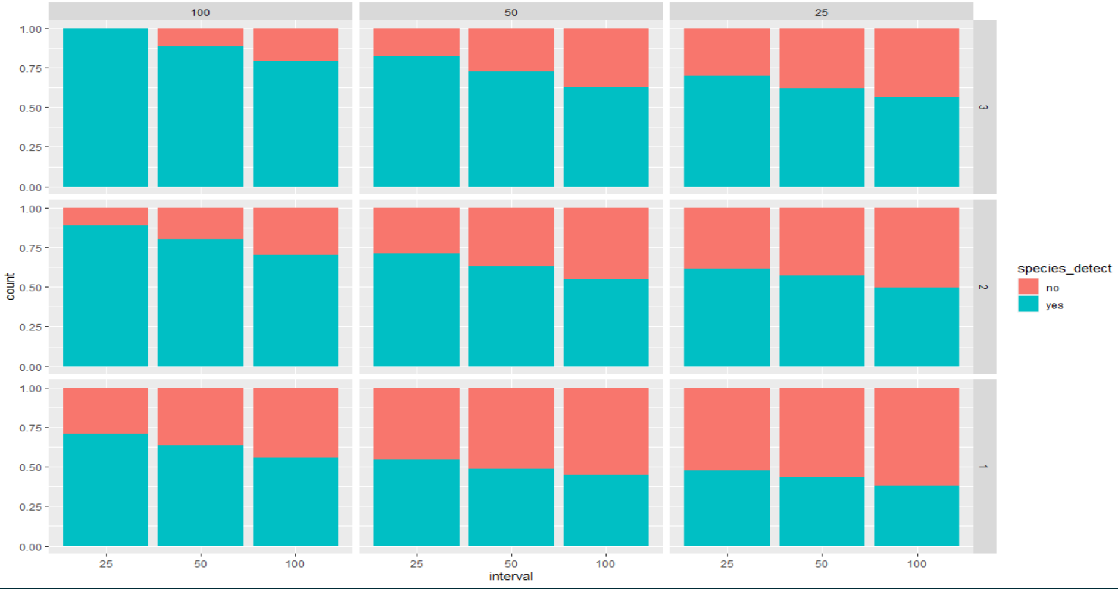
Species detection – proportion of species not detected

Slide 18
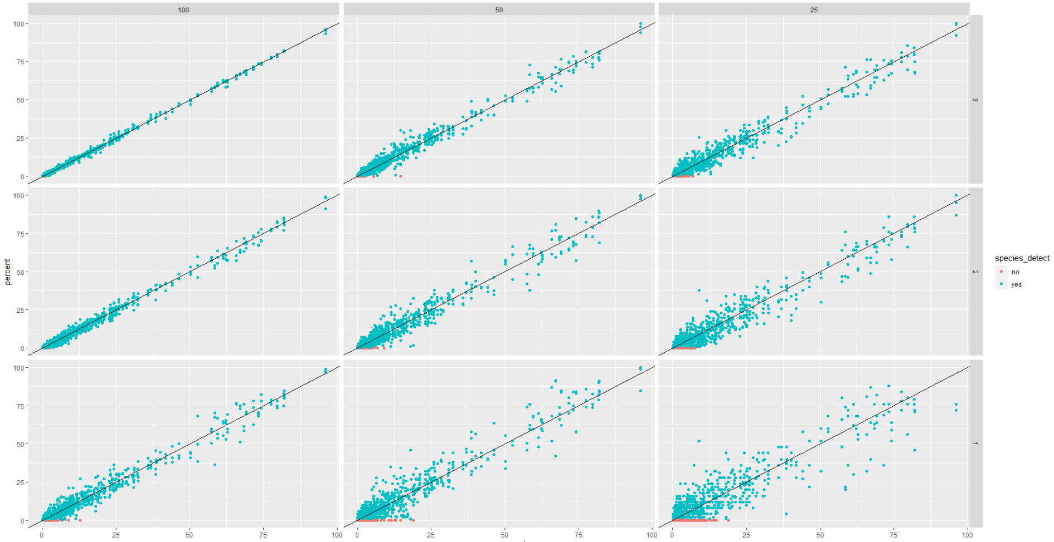
Species detection –species not detected as a function of cover

Slide 19
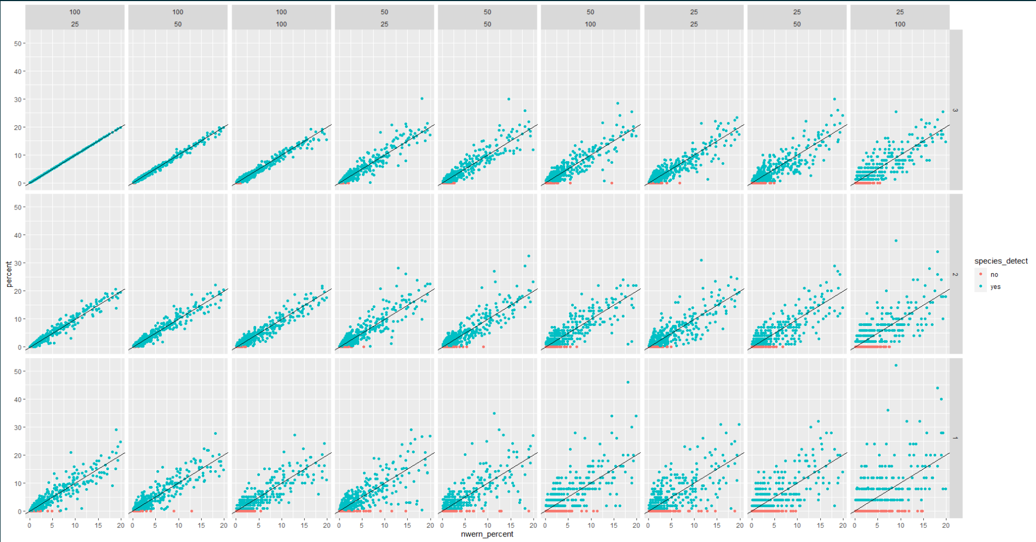
Species detection –species not detected as a function of cover, only NWERN values <20% (species > 20% cover always detected)

Slide 20
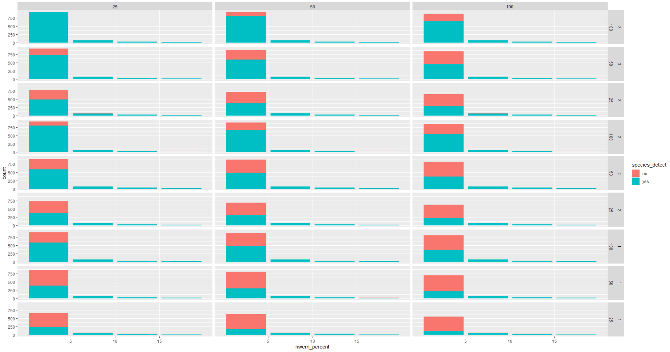

Slide 21
Height

Slide 22
Gap

Slide 23
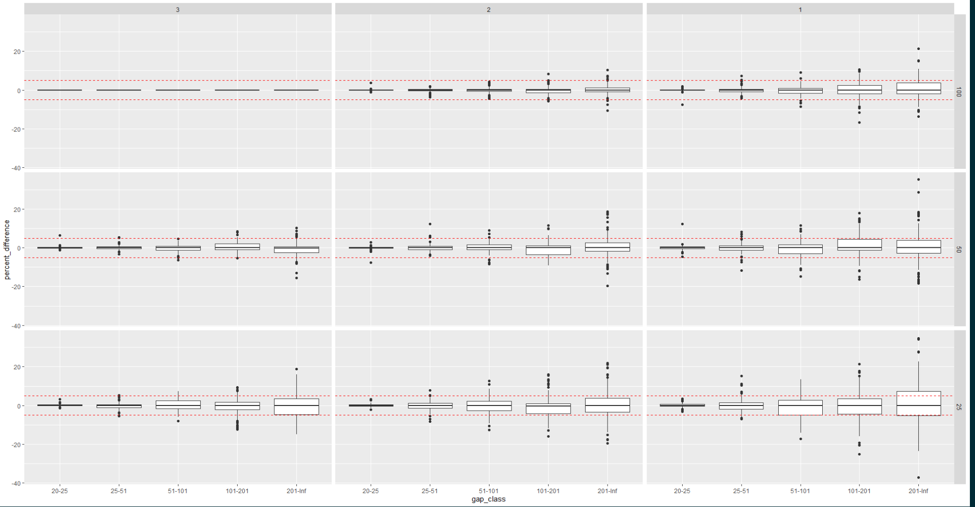
Difference from NWERN base

Slide 24
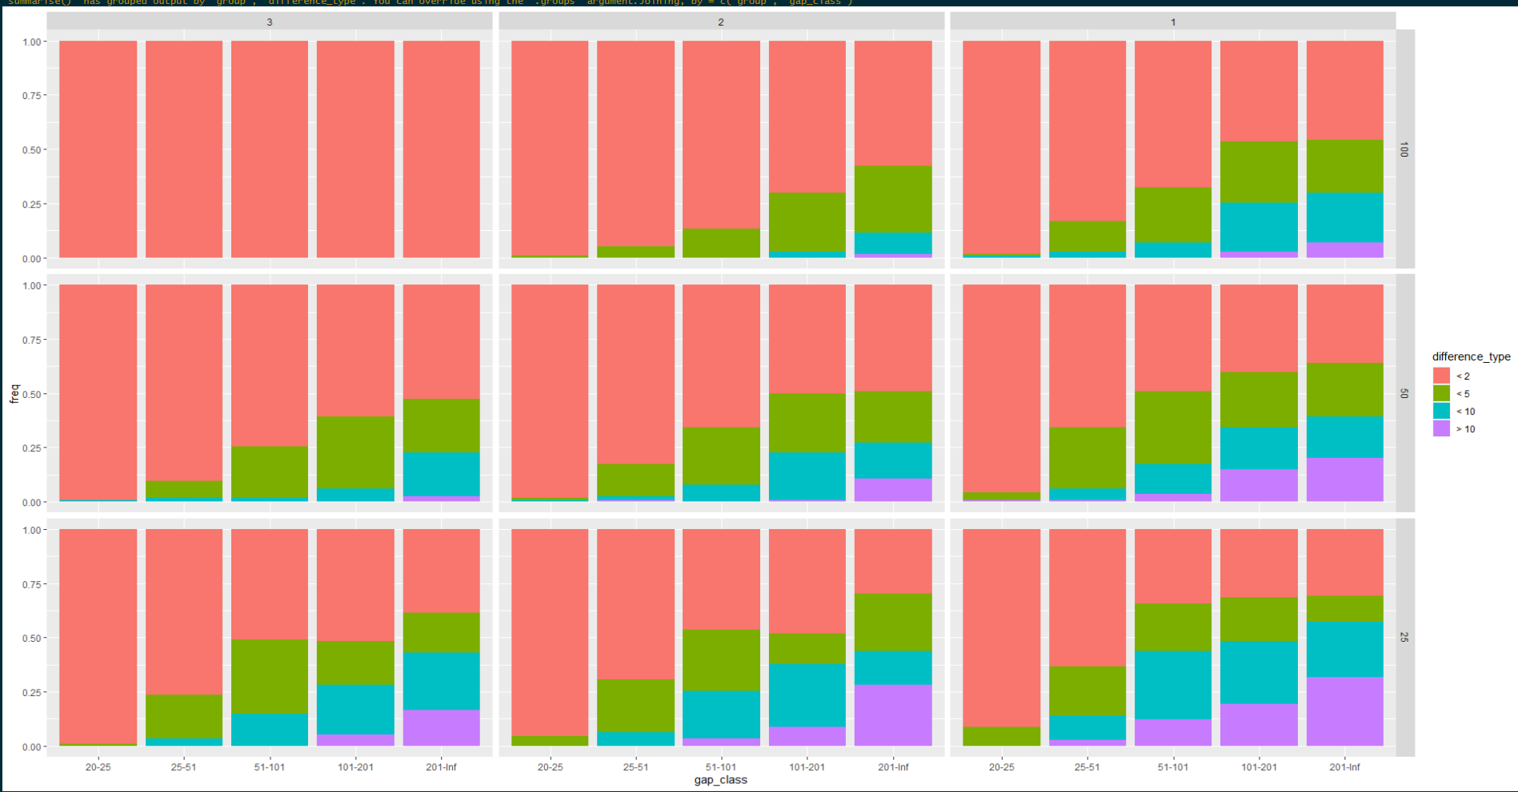
Proportion of difference from NWERN Base

Slide 25
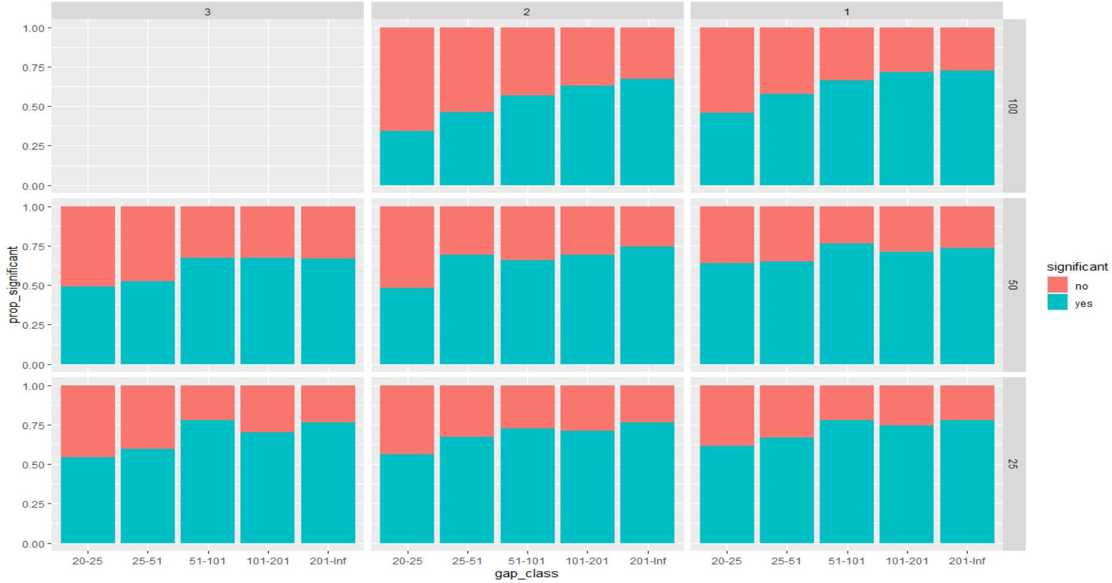
Proportion significantly different from base nwern

